Slide 1
The Gray code
Introduction:
It is non weighted code in which each number differs from previous number by a single bit.
or
Only one bit is changed as we move from one number to another successive number.
CD
00
01
11
10
AB
0
1
2
3
00
7
6
5
4
01
8
9
10
11
11
15
14
13
12
10

Slide 2
Dec. | Binary | Gray
0 | 0 0 0 0 | 0 0 0 0
1 | 0 0 0 1 | 0 0 0 1
2 | 0 0 1 0 | 0 0 1 1
3 | 0 0 1 1 | 0 0 1 0
4 | 0 1 0 0 | 0 1 1 0
5 | 0 1 0 1 | 0 1 1 1
6 | 0 1 1 0 | 0 1 0 1
7 | 0 1 1 1 | 0 1 0 0
8 | 1 0 0 0 | 1 1 0 0
9 | 1 0 0 1 | 1 1 0 1
10 | 1 0 1 0 | 1 1 1 1
11 | 1 0 1 1 | 1 1 1 0
12 | 1 1 0 0 | 1 0 1 0
13 | 1 1 0 1 | 1 0 1 1
Dec. | Binary | Gray
14 | 1 1 1 0 | 1 0 0 1
15 | 1 1 1 1 | 1 0 0 0

Slide 3
The Excess-3 code
It is an important BCD code , is a 4 bit code and used with BCD numbers
To convert any decimal numbers into its excess-3 form ,add 3 to each decimal digit and then convert the sum to a BCD number
As weights are not assigned, it is a kind of non weighted codes.
Convert the following into Excess-3 number
a)149 b) 2546 c) 152 d) 2694
Add the following numbers in excess-3 code
a) 108+789 b) 275+496

Slide 11
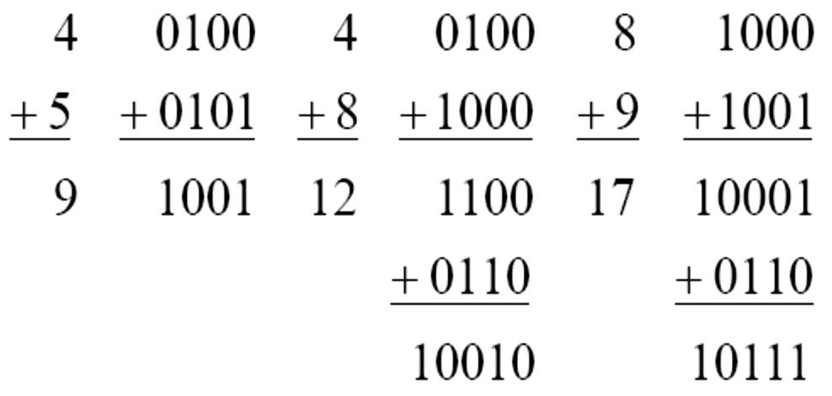
BCD addition
Add two numbers as same as binary addition
Case 1: If the result is less than or equals to 9 and carry is zero then it is valid BCD.
Case 2: If result is greater than 9 and carry is zero then add 6 in four bit combination.
Case 3: If result is less than or equals to 9 but carry is 1 then add 6 in four bit combination.

Slide 12
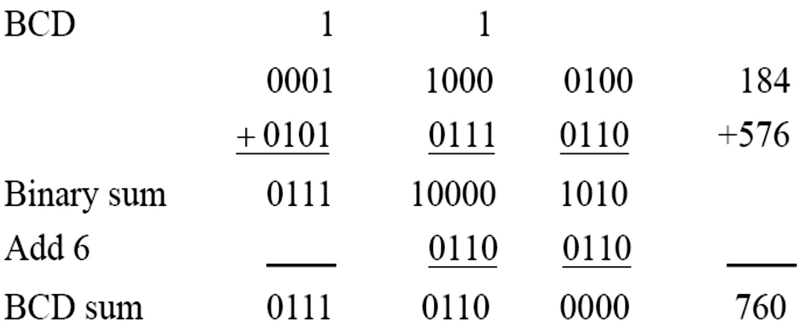
BCD Addition
 Example:
◆ Consider the addition of 184 + 576 = 760 in BCD:

Slide 15
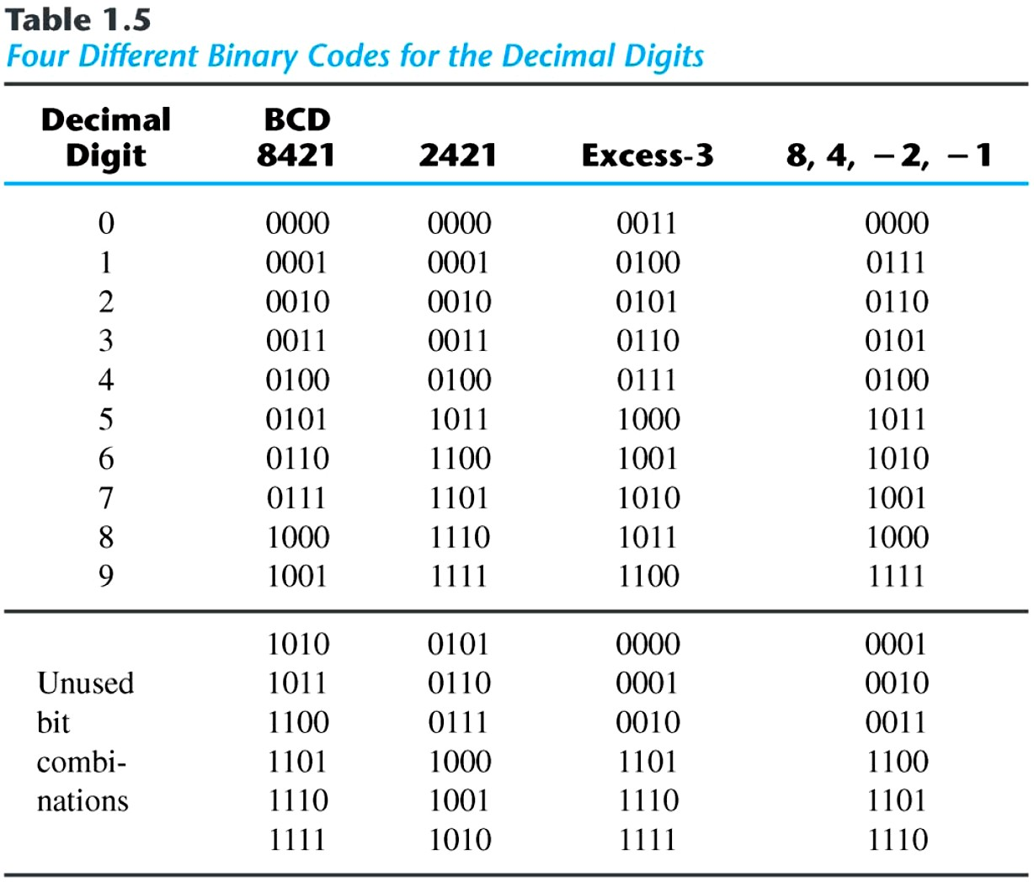
Binary Codes
 Other Decimal Codes

